Slide 1
Middle east wrap up

Slide 2
objectives
Review importance of geographic region.
Explore impact of Arab Spring
Identify key events & players in Arab-Israeli Conflict.
Describe issues holding up the peace process.

Slide 3
Geography review
Land
Primarily Desert
Mountain Ranges
Key Rivers
Peoples
Arabs > 50% peoples
Most Muslim
Israel Jewish nation
Large ethnic groups struggle for sovereignty
Key Nations
Turkey
Syria
Lebanon
Israel
Jordan
Iraq
Iran
Saudi Arabia
Egypt

Slide 4
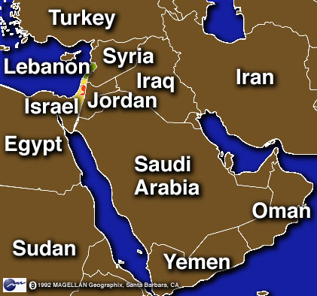
Geography review
Why is this region important?
Connects 3 Continents
Vital Resources
Religion

Slide 5
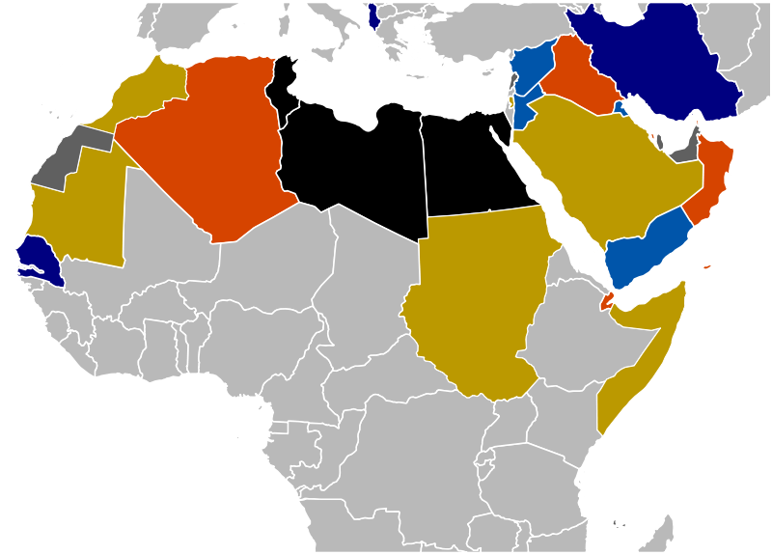
Arab Spring
Causes?
Economic Conditions
Poly Conditions
Face of Revolution?
Youth
Radicals
Role of Social Media?
Twitter, Facebook, Youtube
Evaluation
Overthrown? Continuing? Reforms?
Impact on US?

Slide 6
“Peoples of the Book”
Judaism
Canaan -> Egypt -> Sinai -> Fertile Crescent -> Diaspora
Christianity
Roman ruled Pal -> messiah -> crucifixion -> Spread
Islam
Muhammed prophet -> Mecca -> Medina -> Back
Caliphs spread 5 pillars -> Sunni/Shiite split
Fundamentalism
Why return to tradition?
Jihad & violence
Islamaphobia

Slide 7
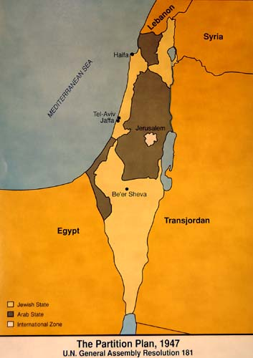
History Arab-Israeli Conflict
How did the Balfour Declaration lead to UN Resolution 181?
Arab nations and Israel clashed in what 4 wars?
What are occupied territories?

Slide 8
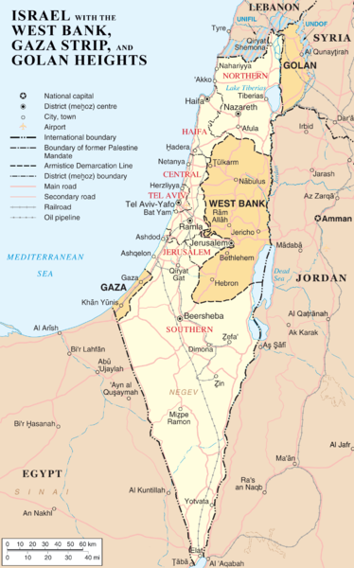
Arab-Israeli Peace Efforts
Which nation was 1st to recognize Israeli’s right to exist?
What is the significance of the 1993 Oslo Accords?
What is the Road Map?

Slide 9
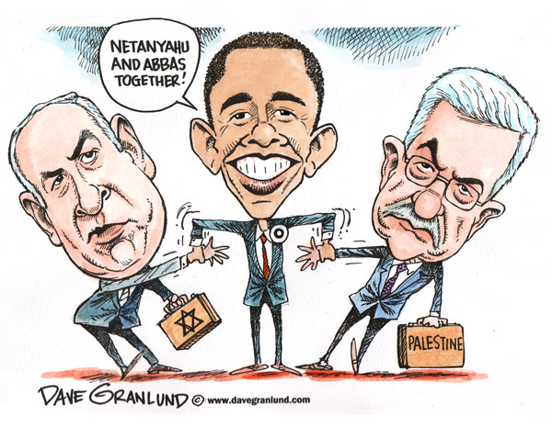
Current peace negotiations
Who are the key players in the Middle East Peace talks?
What issues are preventing a final status resolution?

Slide 10
Video – MID EAST CONFLICT
http://player.discoveryeducation.com/index.cfm?guidAssetId=51DEA021-5F39-4FAB-AE35-B893855D88E4&blnFromSearch=1&productcode=US

Slide 11
Reflection
End of unit reflection on skills, project, structure, and theme.
Handout

